Slide 1
State of the Township
Town Of The City of Champaign
2013-2017

Slide 2
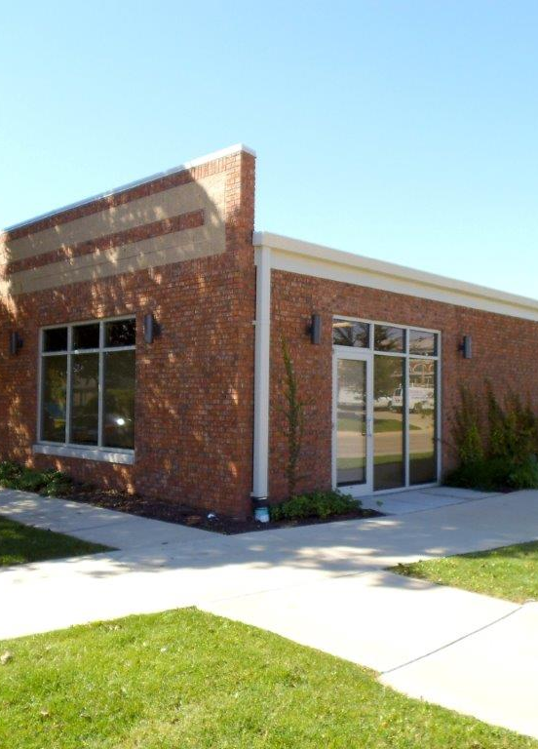
Township Supervisor
-Social Service Branch of Local Government
-Provides State Mandated General Assistance (GA-TA)
-Provide Emergency Assistance
-Provide Housing Assistance
-Case Management
-Collaboration with Non Profits and Other Agencies

Slide 3
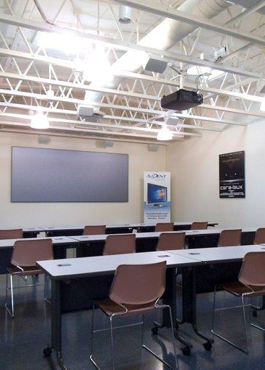
Township Assessor
-Assesses Property at Fair Cash Value
-Assessment is Used to Determine a Taxpayer’s Overall Share of Tax Burden
-Excepts Homestead and Senior Exemptions
-Responsible for 23,715 parcels valued at 1.75 Billion (7/1/16)

Slide 4
Year 1
Increased social media presence-Twitter (@cctownship) and Facebook (City of Champaign Township)
Connected to UC2B (Sig. cost savings, increased speed)
Joined Illinois Funds (Increased efficiency, security, transparency)
Cradle 2 Career Support/Partner
New Digital Phone System (Significant Cost Reduction)
Began Voter Registration (Online Pilot Program)
Contracted with City for Services (IT, Legal, HR)
Cut Township costs (utilities, contracts, etc. by 50%)

Slide 5
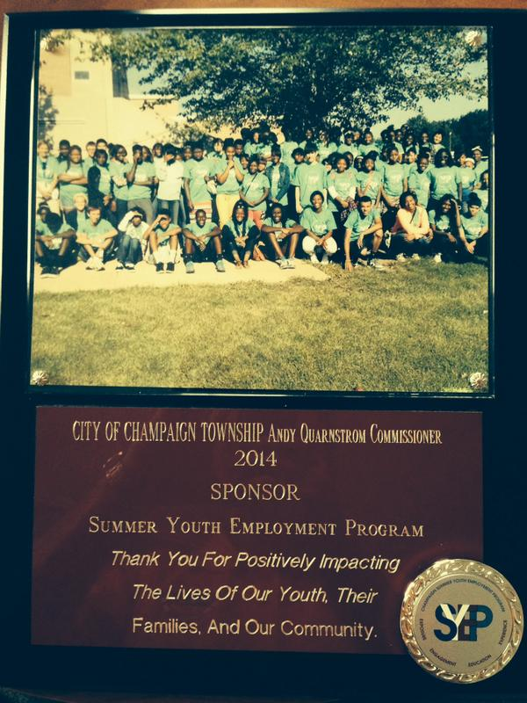
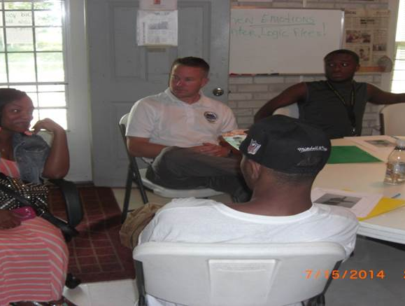
Year 2
Metanoia and Township Youth Pilot Program (culminated with council play)
Unit4 SYEP Sponsorship
Increased General Assistance to $250
Rewrote Employee Handbook
Enrolled all Township Clients into ACA ($25k annual savings)
Contracted with Newcomb Township for GA services
Collaborate with Unit 4 on Homelessness and Prevention

Slide 6
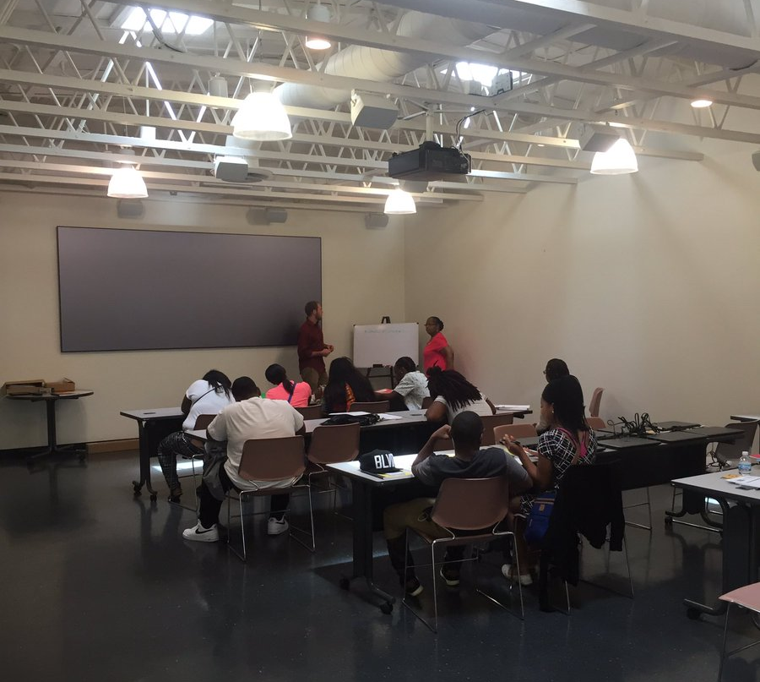
Year 3
New Town Hall at 53 E. Logan
New logo for 50 year anniversary of the Township
New web site (www.cctownship.com)

Slide 7
Current year
Increased General Assistance to $260
Formed partnership agreement with Regional Planning and HUD for Emergency Family Shelter extended housing
Review annexation of 787 parcels in SW Champaign
Continued Planning for Future Youth Programs
Hosting Events (ICASH, Smart Money Week, etc.)

Slide 8
General Assistance

Slide 9
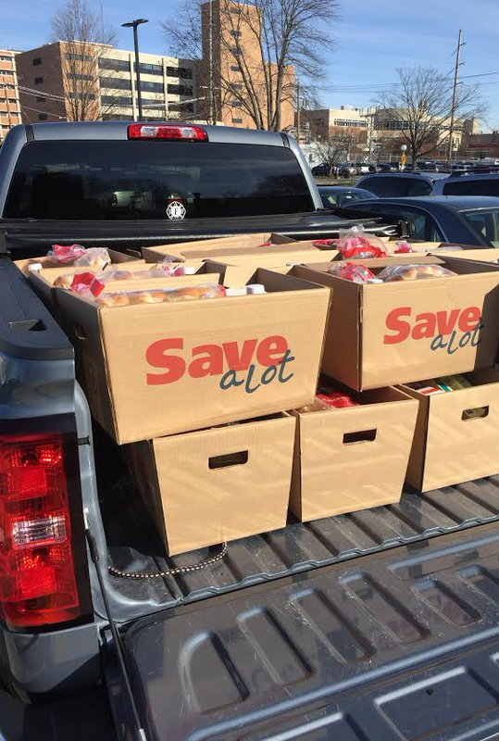
Thanksgiving baskets with St. Patrick Church
Senior Summer Fan Program
Strong belief in transparent government, all documents are available on the web site www.cctownship.com
Same levy rate last 4 years
Continued Financial Support of Unit 4 SYEP

Slide 10
Future goals
Additional GA contracts with Smaller Townships
Spearheading a County Wide Township Association
Expansion and Greater Collaboration of the Township Youth Program
Increase General Assistance Grant for 2017/2018
Greater Collaboration Between Assessor and Supervisor
Expansion of the Assessor’s Records Management System
Expansion of the GA program Post State GA Rewrite
Clarification of SW Champaign Annexation and Related Issues

